Slide 1

Notes:
Danny:
Introduce our project

Slide 2

Who We Are
Daniel Cassinis
Chris Renner
May 5, 2009
Sponsor:
Google.org
Advisors:
Dr. Fletcher Miller
Dr. Arlon Hunt
Notes:
Danny:
Read this slide, introduce us

Slide 3
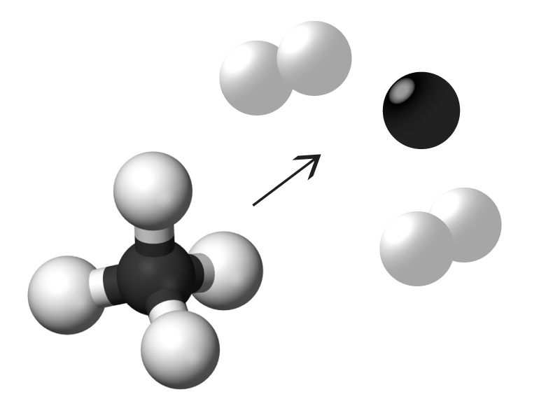
What We Are Doing
Pyrolyzing Methane Gas:
Separating carbon and hydrogen particles by addition of heat.
We are interested in the carbon.
Simplified reaction, actual reaction occurs in 4 smaller steps.
Minimum temperature for reaction is 600 °C, ideal temperature is 900 °C
Reaction time is between 0.1 to 1 second
Notes:
Chris:
Describe the chemical reaction that we are performing
Mention the reaction is more complex, temperature range for reaction to occur, and residence time for reaction

Slide 4
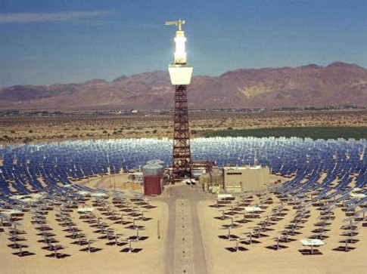
Why
Carbon particles have high surface area to volume
Ideal for absorbing radiant energy, transforming it to heat, and efficiently transferring the heat to a surrounding fluid
In Other Words…
The particles will absorb solar radiation, heat pressurized air until particles vaporize. Heated gas expands through a turbine ultimately generating electricity in a solar thermal power cycle.
Notes:
Danny:
Discuss why we are doing this project
Briefly mention the picture; shows the configuration of current solar thermal power plants using a Rankine cycle
The difference between the Rankine cycle and our design is the working fluid (mineral oil, liquid salts, or water vs air)
Efficiency; approximately 15% with current technology vs experimental and theoretical efficiency of 40-45% NEED TO FIND OUT EXACT NUMBER

Slide 5
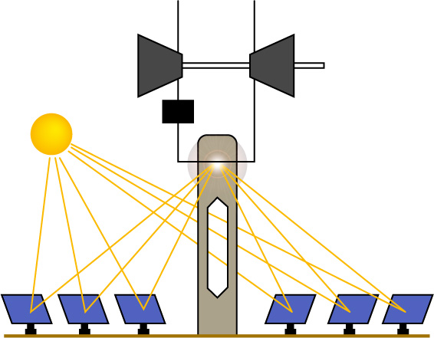

Open Brayton Cycle Solar Thermal Power Plant
Air
Exhaust Gases
1
4
Compressor
Turbine
Shaft Work Out
Carbon
Particles
Particle
Generator
2
3
Collector
Heliostats

Slide 6
Project Objectives
Design a particle generator that works by pyrolyzing methane gas to form carbon particles
Create a clean production of carbon particles
Control of ratio of gases and flow rates
Control of temperature
Control chamber pressure
Accurately measure particle size

Slide 7

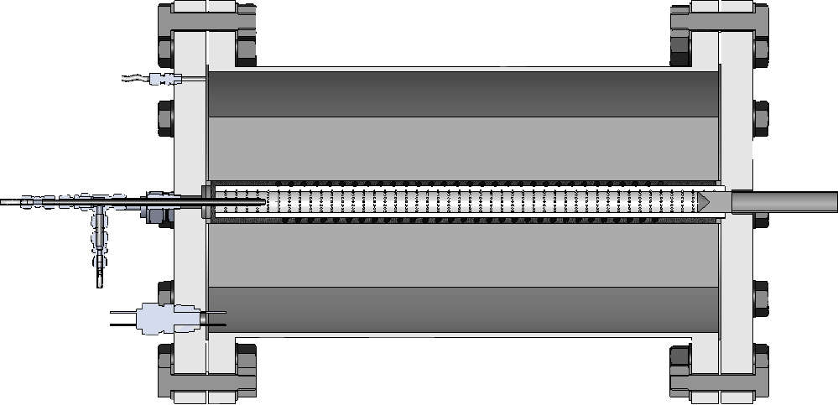
Reaction Chamber
Outer Chamber
Insulation
N₂
Gas Injection
Head
CH₄
Inner Chamber
Heating Coil
Exit Nozzle
Note: Thermocouples and heating coil power leads not shown

Slide 8
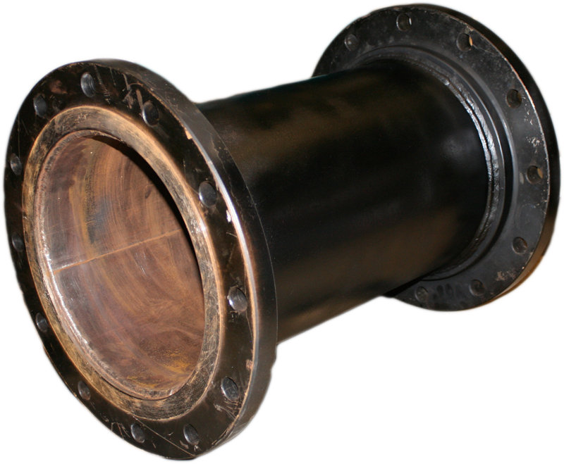
Outer Reaction Chamber
Design Specifications
150 psi maximum pressure
200 °C maximum temperature
Flanged ends for access
ASTM A106 Grade B steel
24” length
12” inner diameter
¼ “ thickness
12 bolt 1” thick flanges

Slide 9
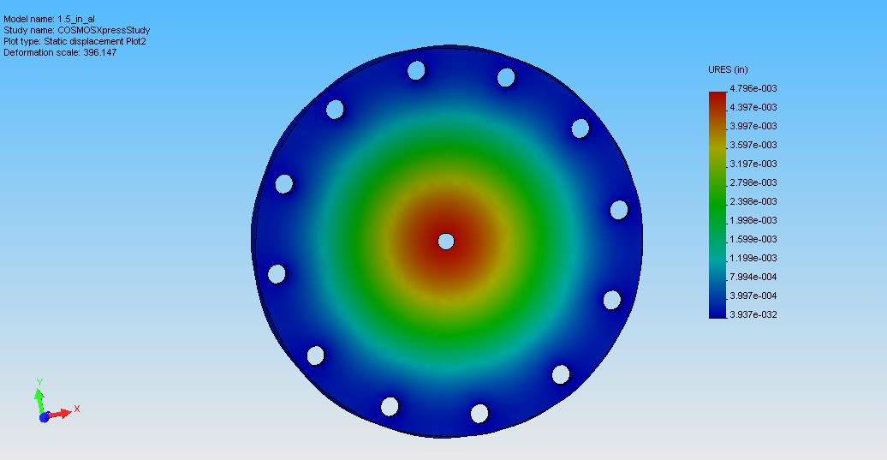
Outer Reaction Chamber cont’d
Endplates extremely heavy, 120 pounds
Because we were removing them for assembly and testing, analyzed aluminum endplate (70 pound weight savings)
Static displacement of 6061 Aluminum Endplate At 150 psi
Maximum deflection of 0.00480” exceeded design specification of < 0.001”

Slide 10
Heat Transfer Calculations
Before proceeding with design:
Heat transfer analysis was performed on system to determine:
  Insulation type and thickness required
  Ceramic tube diameter
  Power requirement for heating coil
Initial conduction analysis for 1000 °C showed insulation thickness of 3”
2-Dimiensional conduction analysis performed on system
Results:
3” insulation thickness acceptable starting point
1” inner diameter tube preferred
650 W minimum power requirement
Surface temperature of steel chamber < 100 °C
Temperature in Kelvin. Credit: Steve Ruther

Slide 11
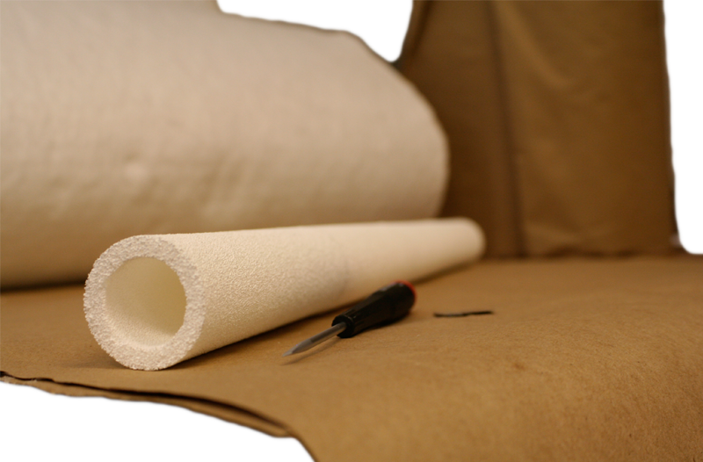
Porous Ceramic Inner Chamber
Built flow tunnel to test pressure drop across ceramic samples
65 pores per linear inch, 92% Al₂O₃ alumina chosen
Diameter determined by previous heat transfer calculations
24” long
1” inner diameter
¼” thickness

Slide 12

Insulation
Durablanket S chosen because of flow testing and heat transfer calculation results
  ¼” thickness
  6.0 lb/ft^3 density
Thickness in reaction chamber controlled by layering
Material also has exceptional durability and bending radius

Slide 13
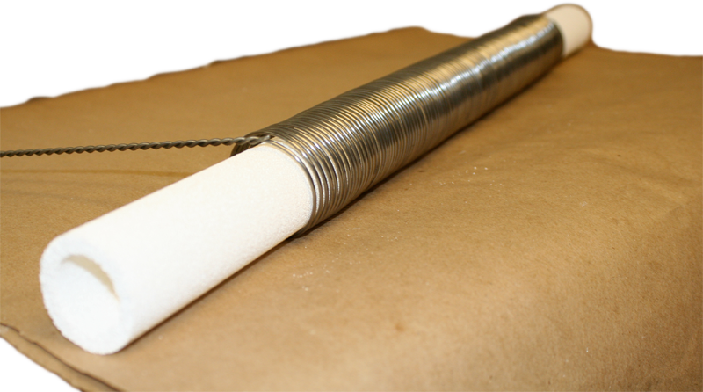
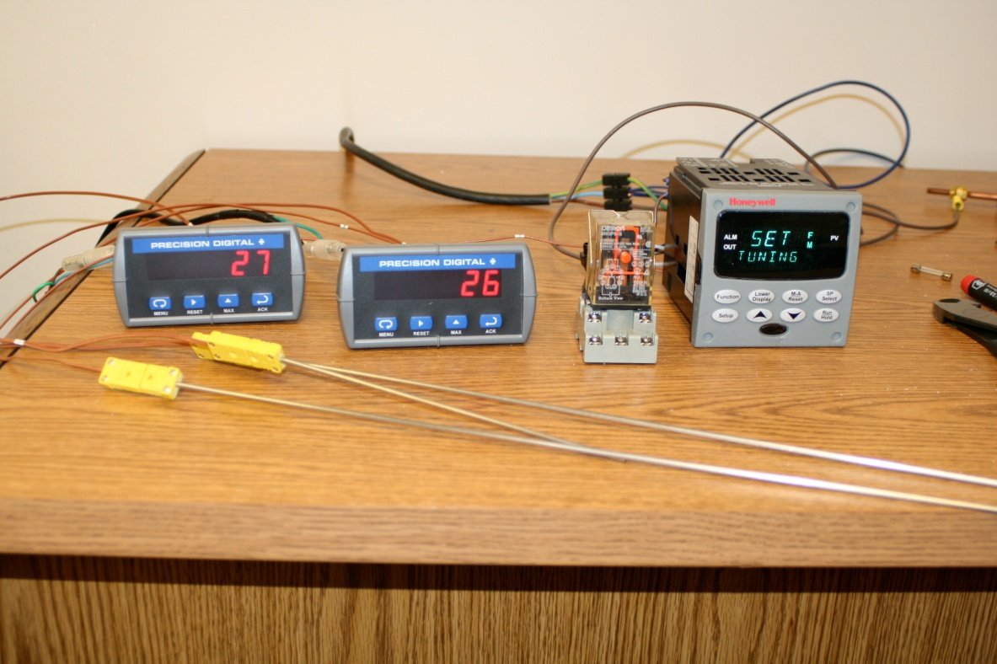
Heating System
Heating Coil
Kanthal “A-F” wire coil
1200 Watts @ 120 Volts
Temperature Displays
Controller
Control and Displays
Honeywell UDC 2500 Universal Digital Controller
  Tunable PID and custom user defined temperature profiles
  Precision Digital Temperature Indicators
  Type K inconel sheath thermocouples
Thermocouples

Slide 14
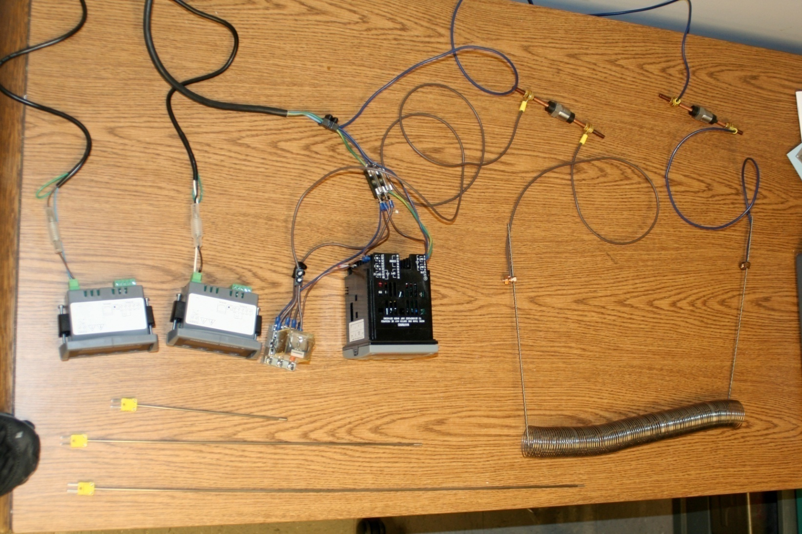
Heating System
Purchased components, wired and programmed ourselves to save money
Power Feedthroughs
Digital Controller
20 Amp Relay
Temperature Displays
Heating Coil
Thermocouples

Slide 15
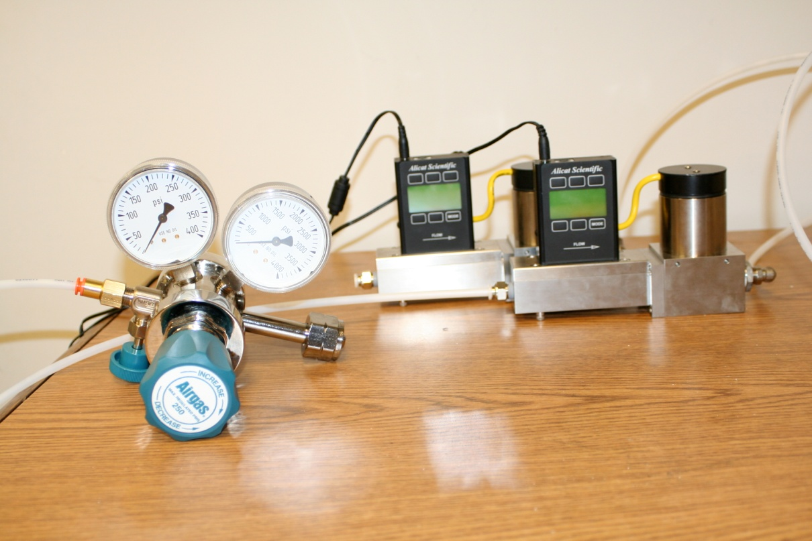
Gas System
Gases used are nitrogen and methane
3 Alicat mass flow controllers are used to control gas flow rates and ratios;
  1 for methane
  2 for nitrogen; injection head and chamber fitting
  2 Airgas pressure regulators used to control gas pressure
Mass Flow Controllers
Pressure Regulator

Slide 16
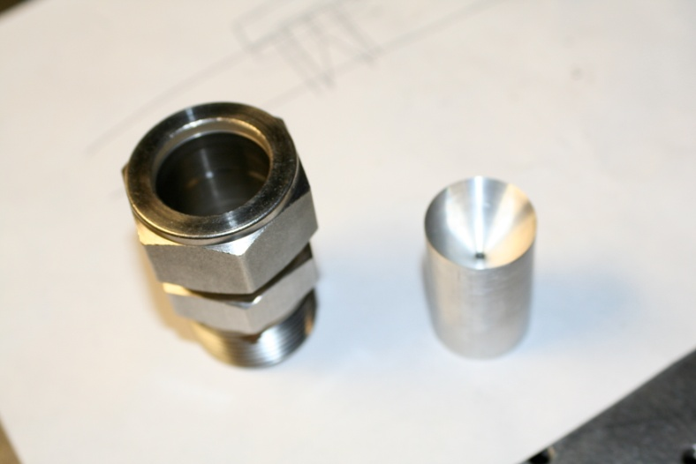
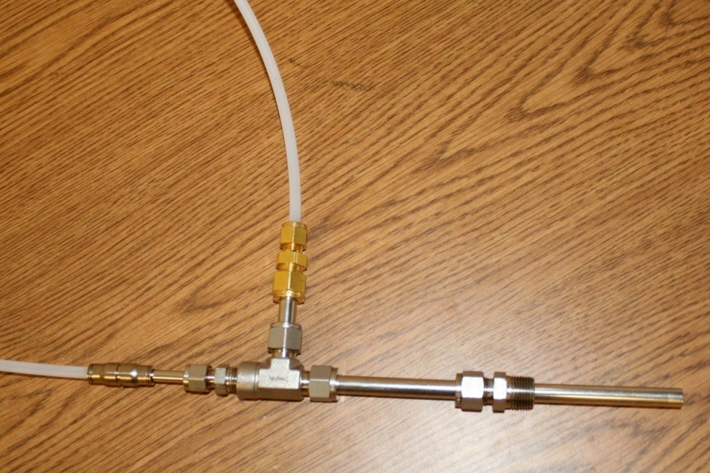

Gas System Cont’d
Gas Injection Head
Coaxial gas flow of nitrogen and methane to prevent coking at methane injection point
Allows depth of gas injection to be controlled for both gases
Nozzle
1” NPT fitting
N₂ Line
Outlet Valve
Risk of explosion or fire at chamber exit; high temperatures, O₂, and H₂
Designed nozzle to fit in exit
  Controls pressure drop and prevents backflow
CH₄ Line
CH₄
N₂
N₂

Slide 17
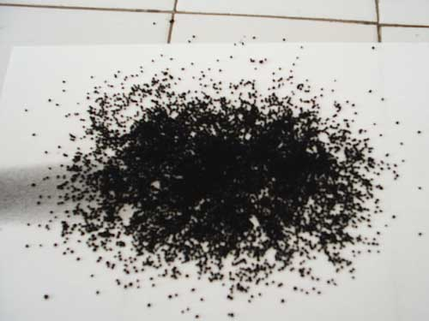
Results
Assembly and setup of all key components complete
Bench testing of all reaction chamber subsystems complete:
  Gas pressure and flow control functional
  Digital controller programmed and coil powered, temperature control functional
  Thermocouples tested and functional
  Inner tube, chamber endplate interface verified
  All major safety concerns have been addressed
Final task is to perform test runs and generate first batch of carbon, concluding first year of the project
Design Specifications:
Carbon Particle Density: 1 – 3 g/m³
Residence Time: ≤ 1 sec

Slide 18








Acknowledgements
Dr. Fletcher Miller
Dr. Arlon Hunt
Google.org
Industronics
Hi Tech Ceramics
Swagelok
San Diego Electronic Supply
Omega
PAVE
Tidelands Oil
McMaster Carr and Marshall’s Hardware

Slide 19

Questions?

